Slide 1



Name
Hassan Ali
StrokeVision - Technical Overview
Date
2025-12-09

Slide 2

Agenda
01
Project Overview & Objectives
02
Architecture & Security
03
Data Management & Pipeline
04
Implementation, Quality & Testing
05
Challenges & Conclusion
06
Demonstration

Slide 3
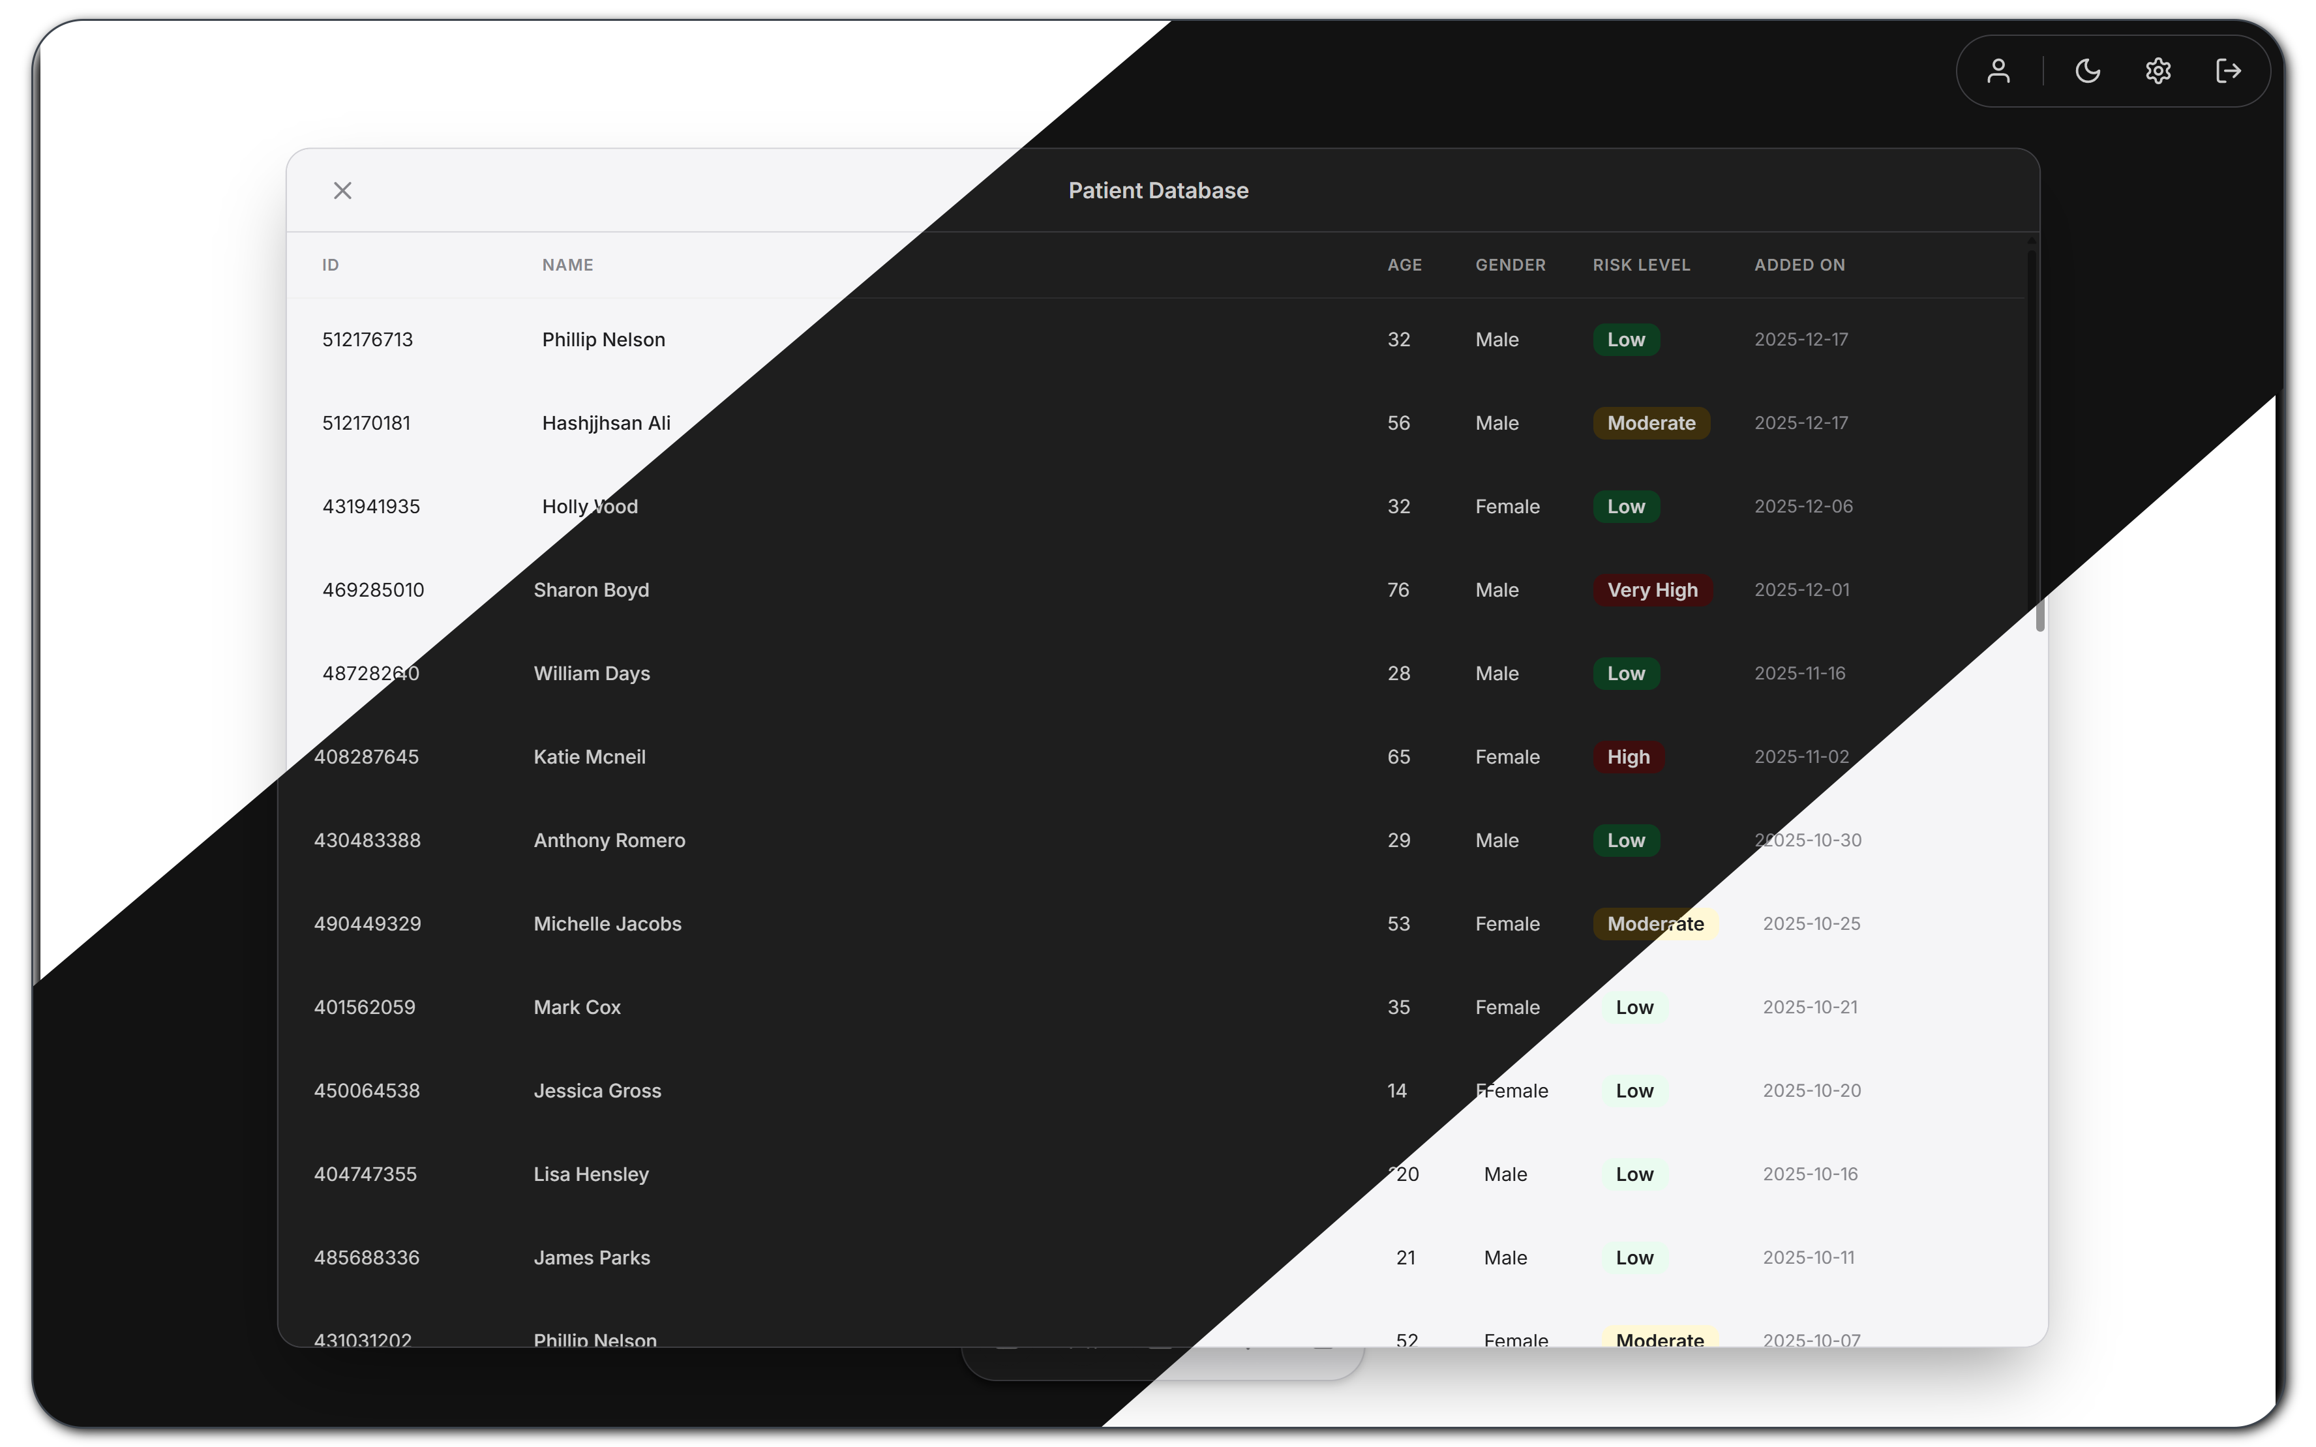
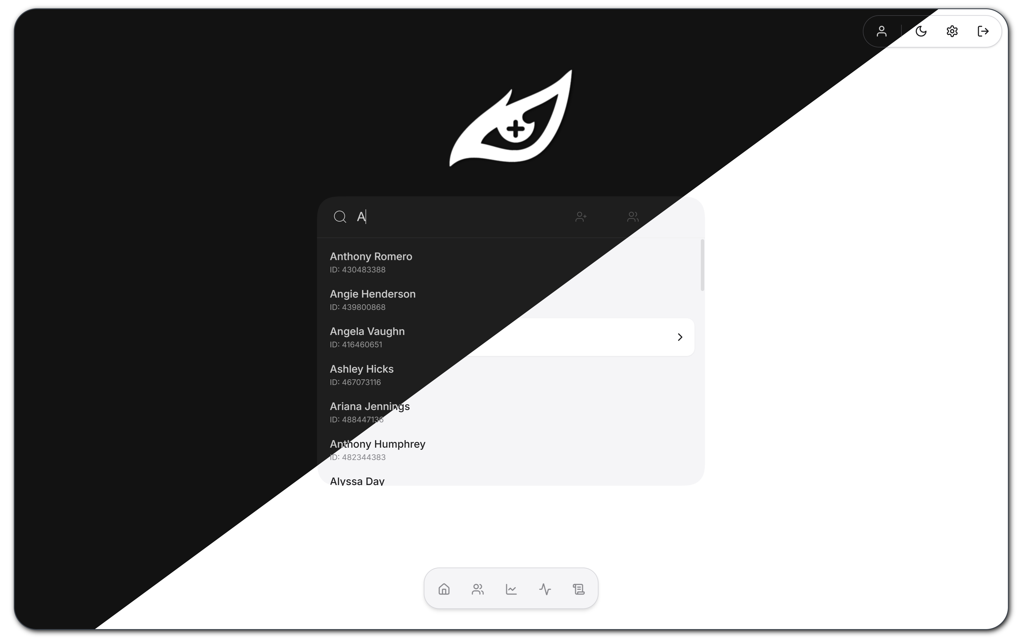
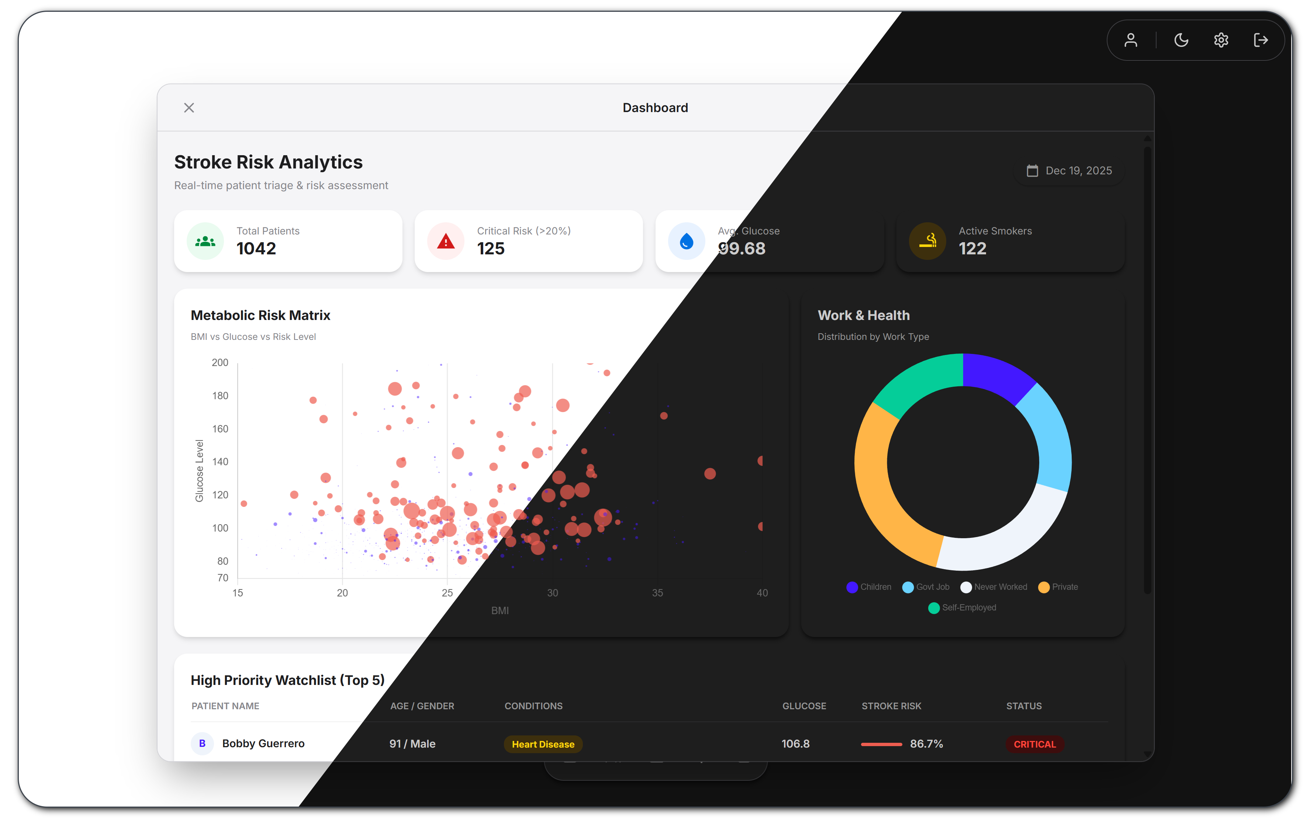
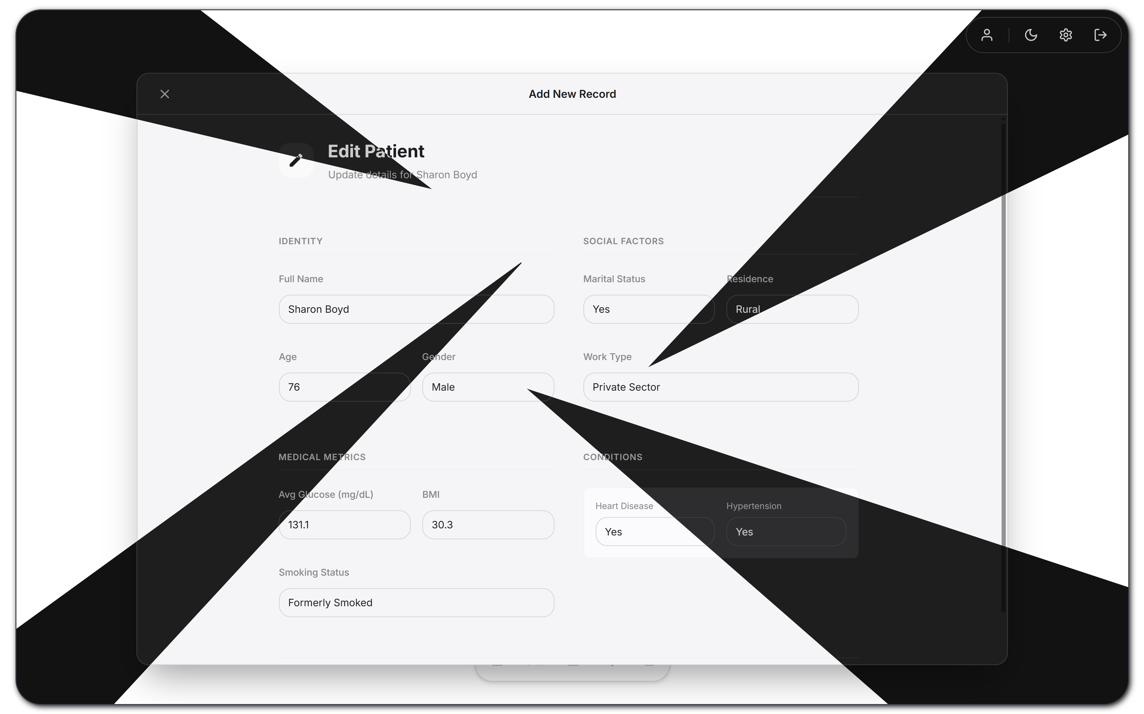
User Interface (Dark Mode Supported)

Slide 4


Project Overview & Objectives
Goal: Patient Management & Stroke Detection
Secure Architecture to store & management sensitive patient data.
A pre-trained Keras/TensorFlow Neural Network to analyze & generate instant stroke probability scores.
Target Audience
Designed for medical professionals and Administrators requiring a secure, role-based environment for patient data management.
Note: Currently, Only For Educational Purposes
Key Features
SPA (Single Page Application) Architecture
Real-time Search
Secure CRUD for Operations
A.I Based Prediction (DNN)
Role-Based Access Control (RBAC) – Dedicated Auth Shield
Intensely Tested (+61 unit tests)
GDPR-compliant data handling practices.

Slide 5



Architecture & SSDLC Alignment
Frontend (SPA)
Flask Backend API
Decoupled Databases
A responsive Single Page Application built with Vanilla ES6+ JavaScript, ensuring fast transitions and a clinical-grade user experience without page reloads.
Serves as a secure RESTful API gateway, managing authentication, request validation, and routing to appropriate micro-services for prediction and data processing.
Separation of concerns: SQLite for User Authentication and storage and MongoDB for flexible, scalable Patient Health Records, reducing the security blast radius.

Slide 6



Security Features Overview
Auth & Data Protection
Input Validation
Network Defense
A hybrid model using Flask-Login sessions for web access and JWTs for API scalability.
Passwords are secured using Bcrypt hashing with a work factor of 12.
Dedicated Auth Shield for secure RBAC
Comprehensive protection via Flask-WTF forms ensuring strict type checking.
Server-side sanitization to prevent XSS and SQL injection attacks.
Global CSRF protection middleware.
Secure HTTP headers (HSTS, X-Frame-Options, HttpOnly cookies) to defend against network-level threats.
Flask limiter to prevent Brute-Force Attacks

Slide 7
Data Management: Privacy & Databases
Feature | SQLite (User DB) | MongoDB (Patient DB)
Data Stored | Admin/Doctor credentials, Roles | Patient Health Records, Risk Scores & Logs
Structure | Relational (SQL) | Document-Based (NoSQL)
Access Control | Isolated Auth Shield, Hashed PWDs | Restricted URI Access, Sanitization, Scalable
Encryption | Bcrypt (At Rest) + AES Encryption | AES Encryption

Slide 8

Data Pipeline & Flow
1. User Interaction
User accesses SPA via HTTPS. Requests for login/registration, data are sent as JSON via secure JWT-authenticated channels.
2. API Processing
Flask REST API validates input headers and CSRF tokens, routing traffic to User_Manager or Patient_Manager services.
3. Persistence & Inference
Authenticated requests reach Auth Shield to access SQLite/MongoDB. PredictionService loads Keras model for real-time risk scoring.

Slide 9


Core Algorithms: Model & Inference
Deep Learning Engine
Powered by a custom-trained Keras/TensorFlow Neural Network optimized for
clinical risk assessment.
Clinical Inputs
Analyzes key patient vitals including Age, BMI, Glucose Level, and Hypertension
history to determine risk factors.
Instant Risk Scoring
Delivers probability scores in real-time via the PredictionService, aiding rapid
clinical decision making.

Slide 10
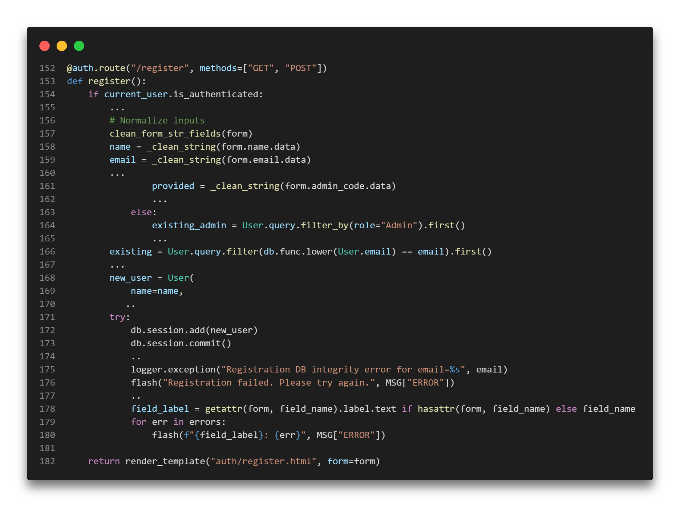
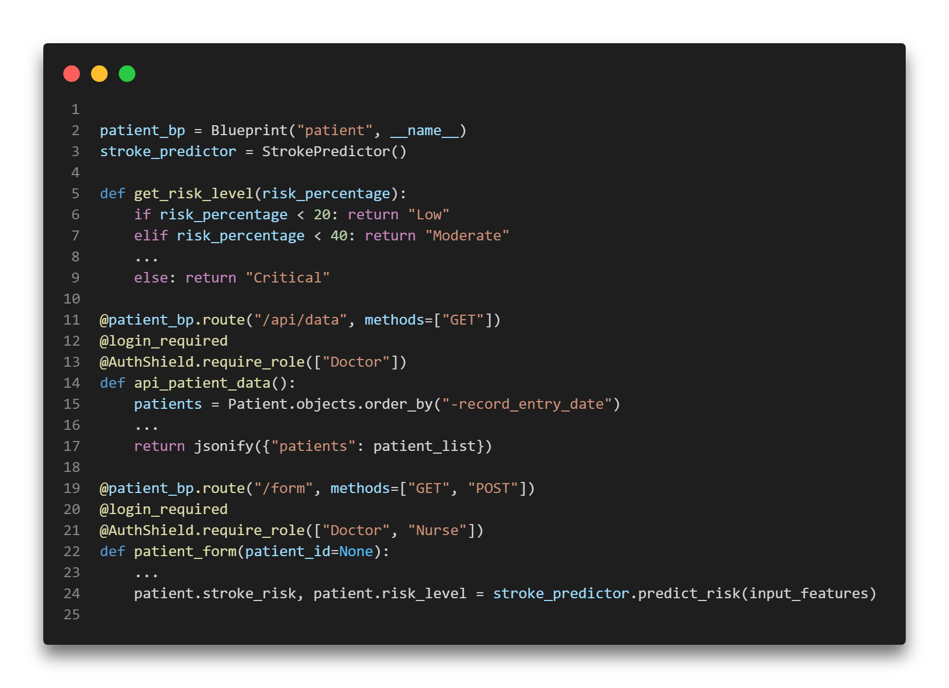
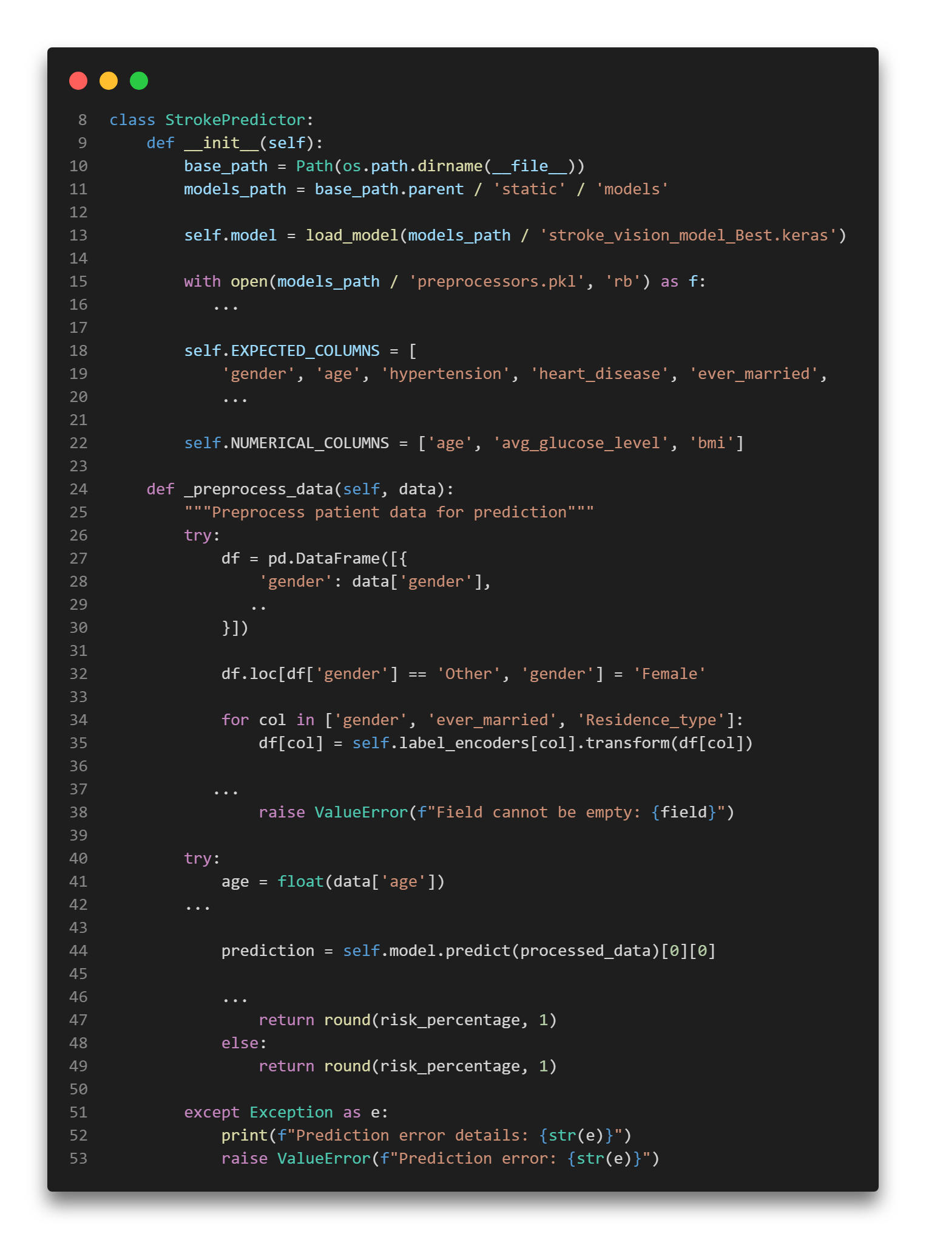
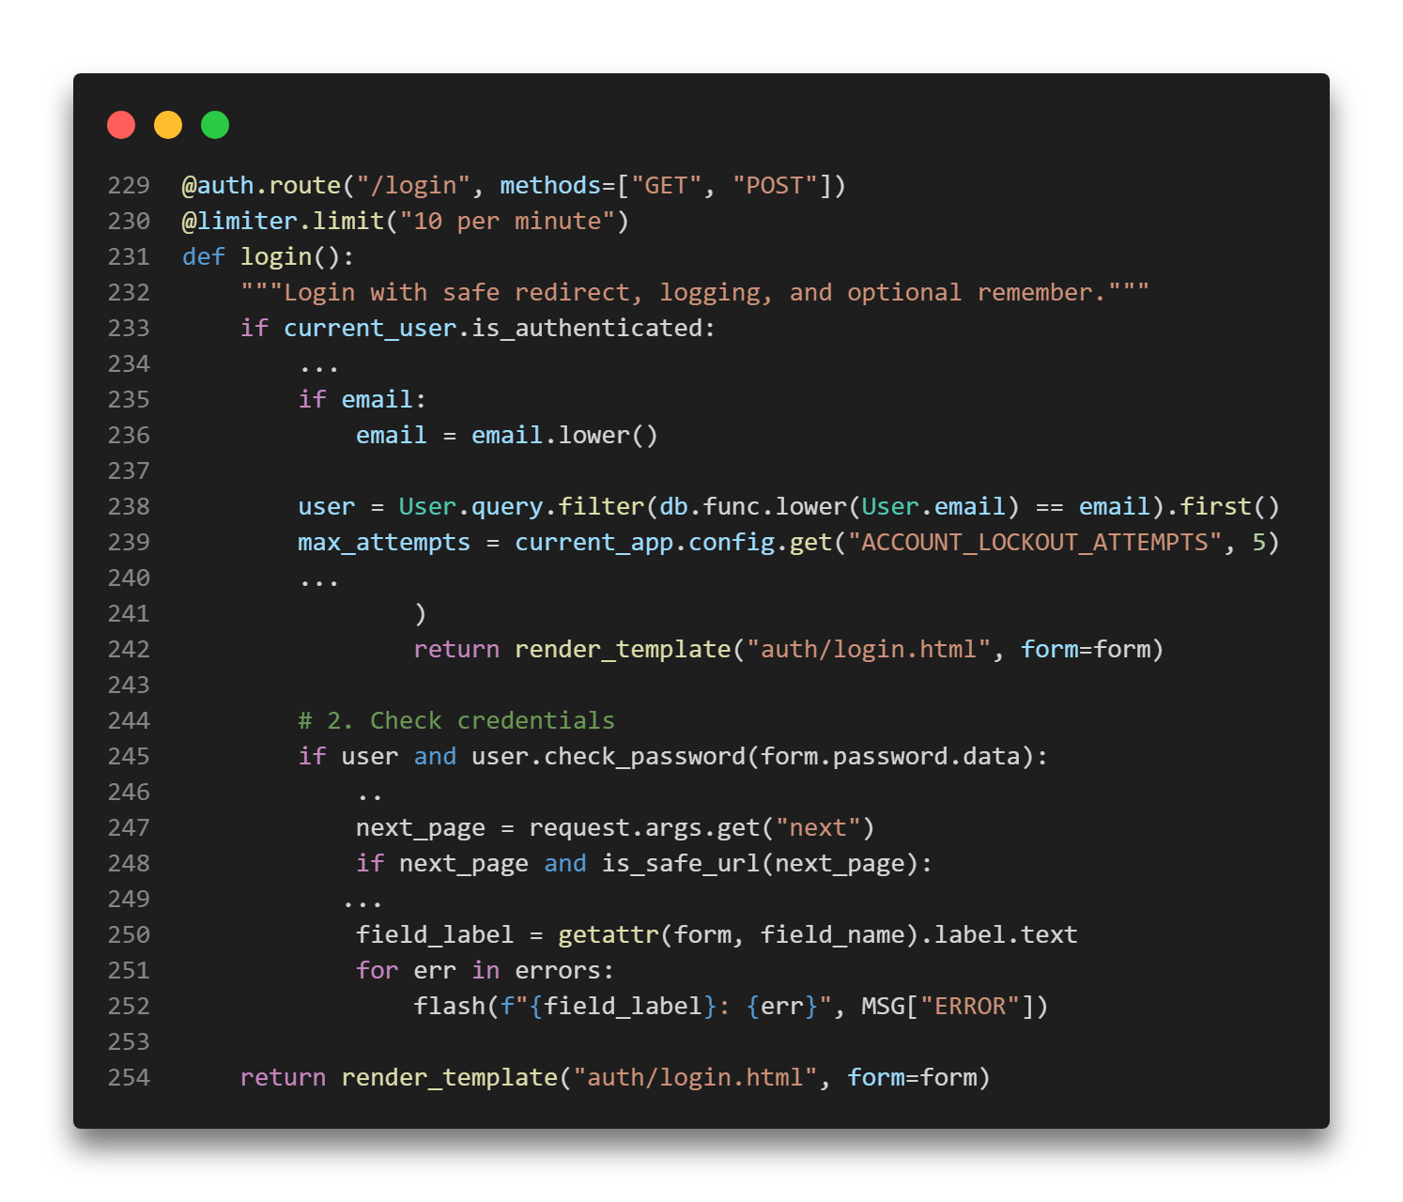
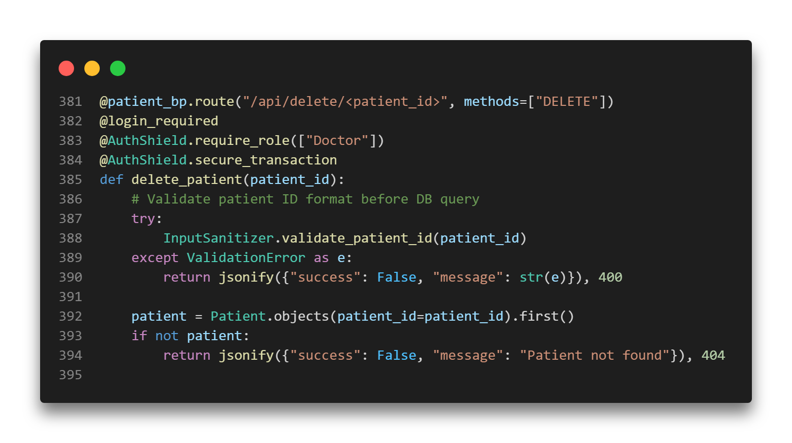
API & Endpoints
User Service
Patient Service
Prediction Service
Handles all authentication and user management.
(For Details, See: Auth.py & User_Manager.py)
Manages CRUD operations for health records. (For Details, See: Patient_Manager.py)
Exposes ML model inference capabilities. (For Details, See: Pridiction.py)

Slide 11
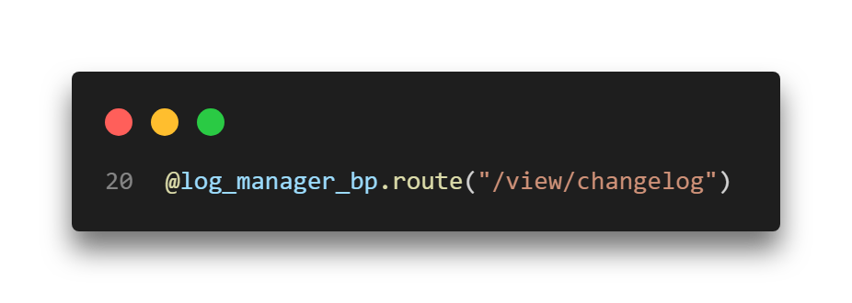
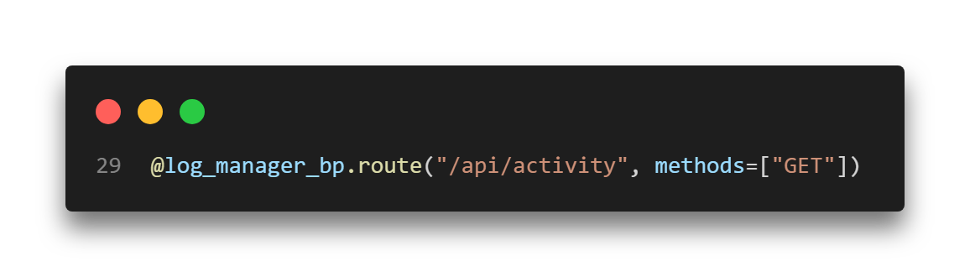
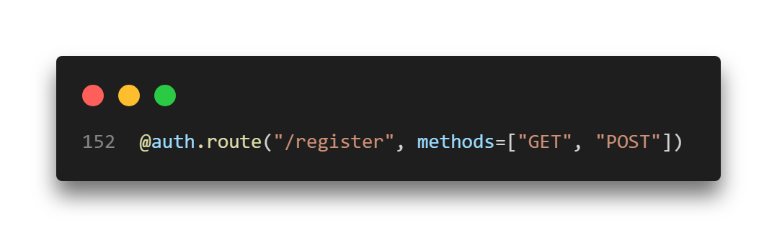
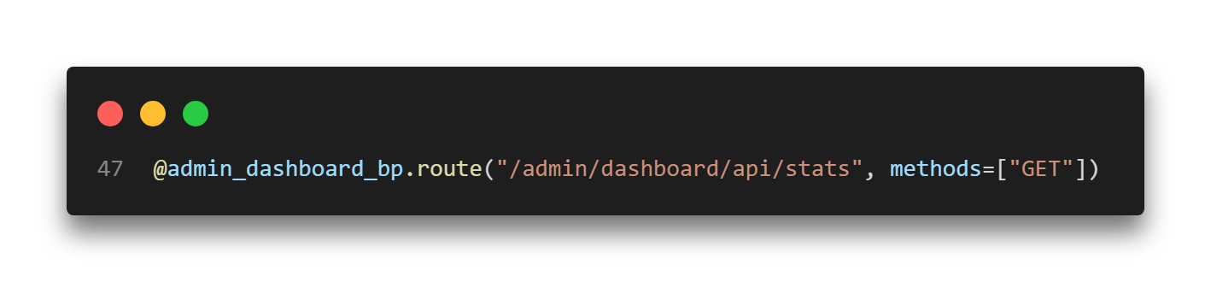

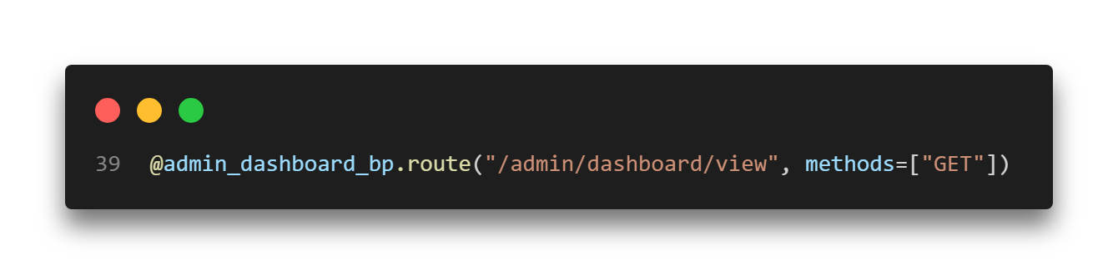
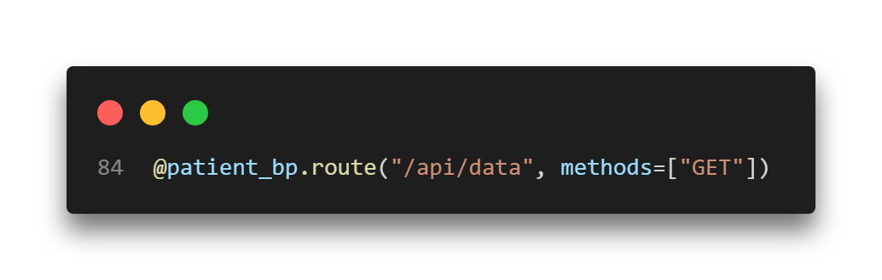
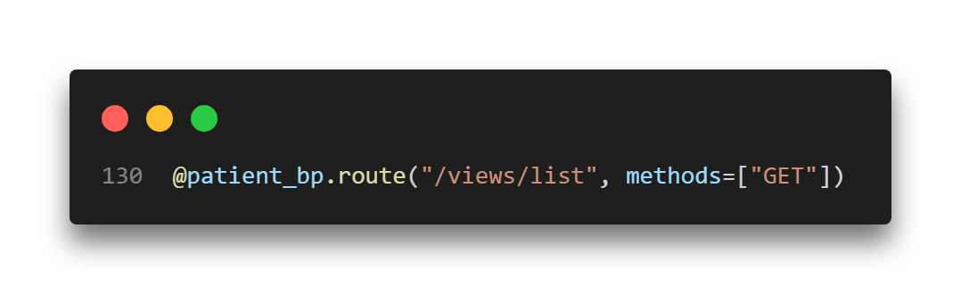
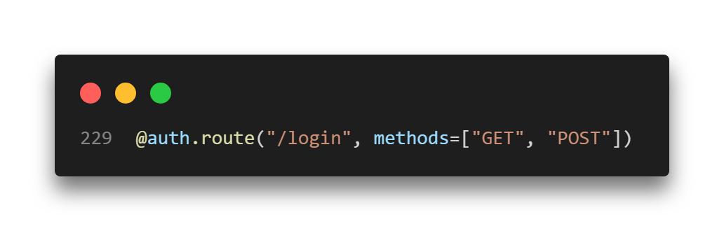
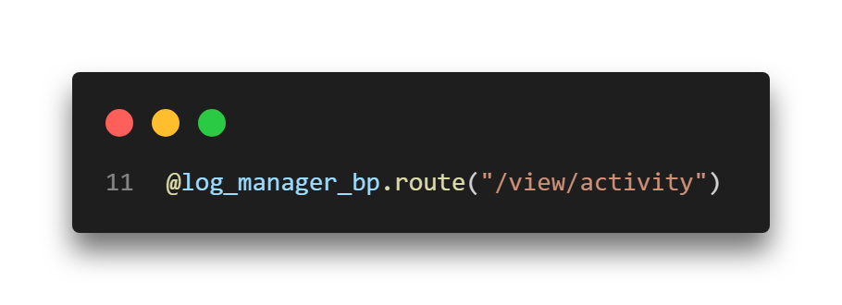
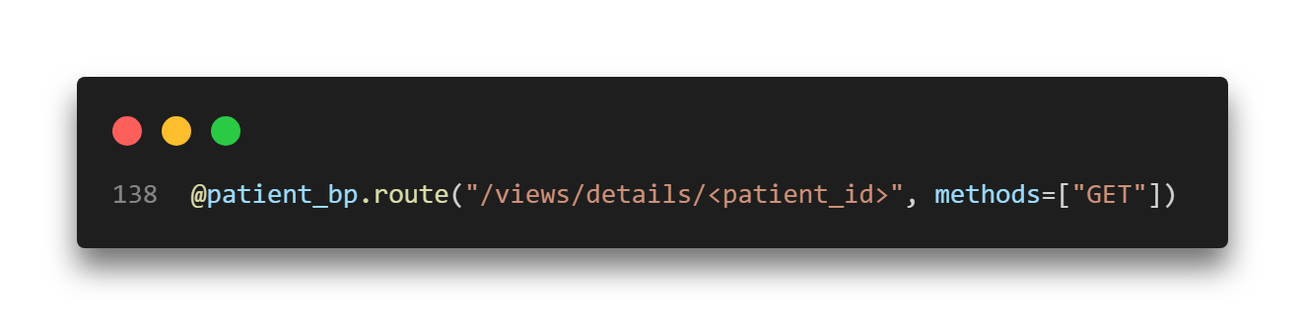
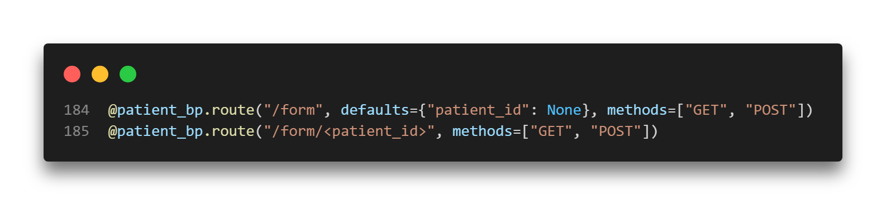
Some Key API Endpoints

Slide 12
Project Structure & Key Modules
Frontend & Assets (static/)
Contains the Single Page Application (SPA) frontend logic, including JavaScript modules, CSS styling,
and client-side routing logic.
Backend Views (views/)
Houses the Flask backend application logic, defining RESTful API endpoints, authentication
handlers, and core business logic.
Data Models (models/)
Defines rigorous database schemas for MongoDB (patient records, logs) and
SQLite (user authentication), ensuring data consistency.

Slide 13



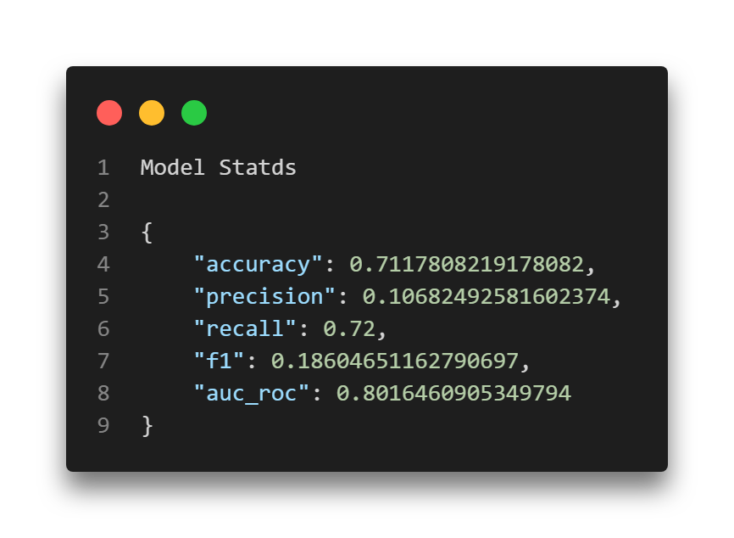
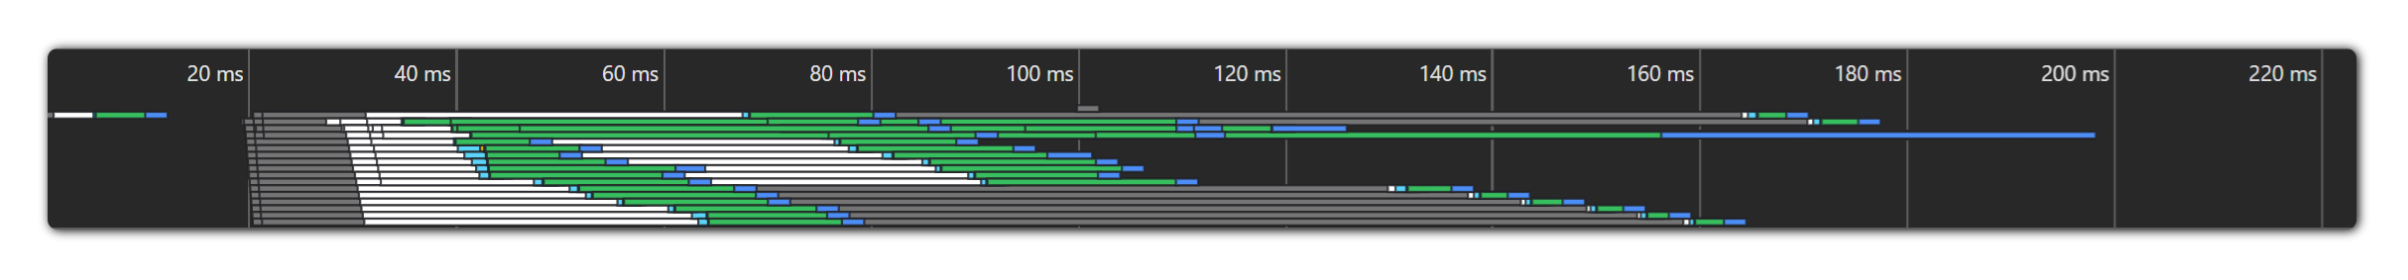
Performance & Metrics
< 200ms
Scalable
71%
Response Time
Architecture
Model Precision
SPA architecture ensures instant page transitions without full reloads, providing a seamless user experience.
Decoupled backend and frontend allows independent scaling of API services and client resources.
High model accuracy for stroke risk prediction, verified against validation datasets.

Slide 14
Testing & Code Quality
Automated Testing
Version Control
Documentation
Comprehensive unit and integration testing suite (+61 unit tests) using pytest.
Verifies auth logic, route access, and model constraints to prevent regressions.
Utilizes Git and GitHub with feature branches and +30 semantic commits.
Maintains a clear history of feature progression and code reviews.
Detailed README, architectural diagrams, documentation and requirement specs ensure the project is maintainable and understandable for future developers.

Slide 15
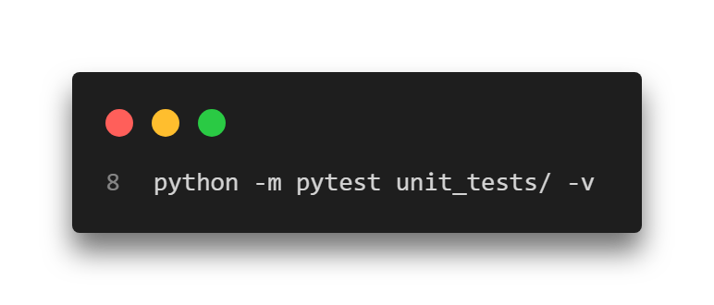
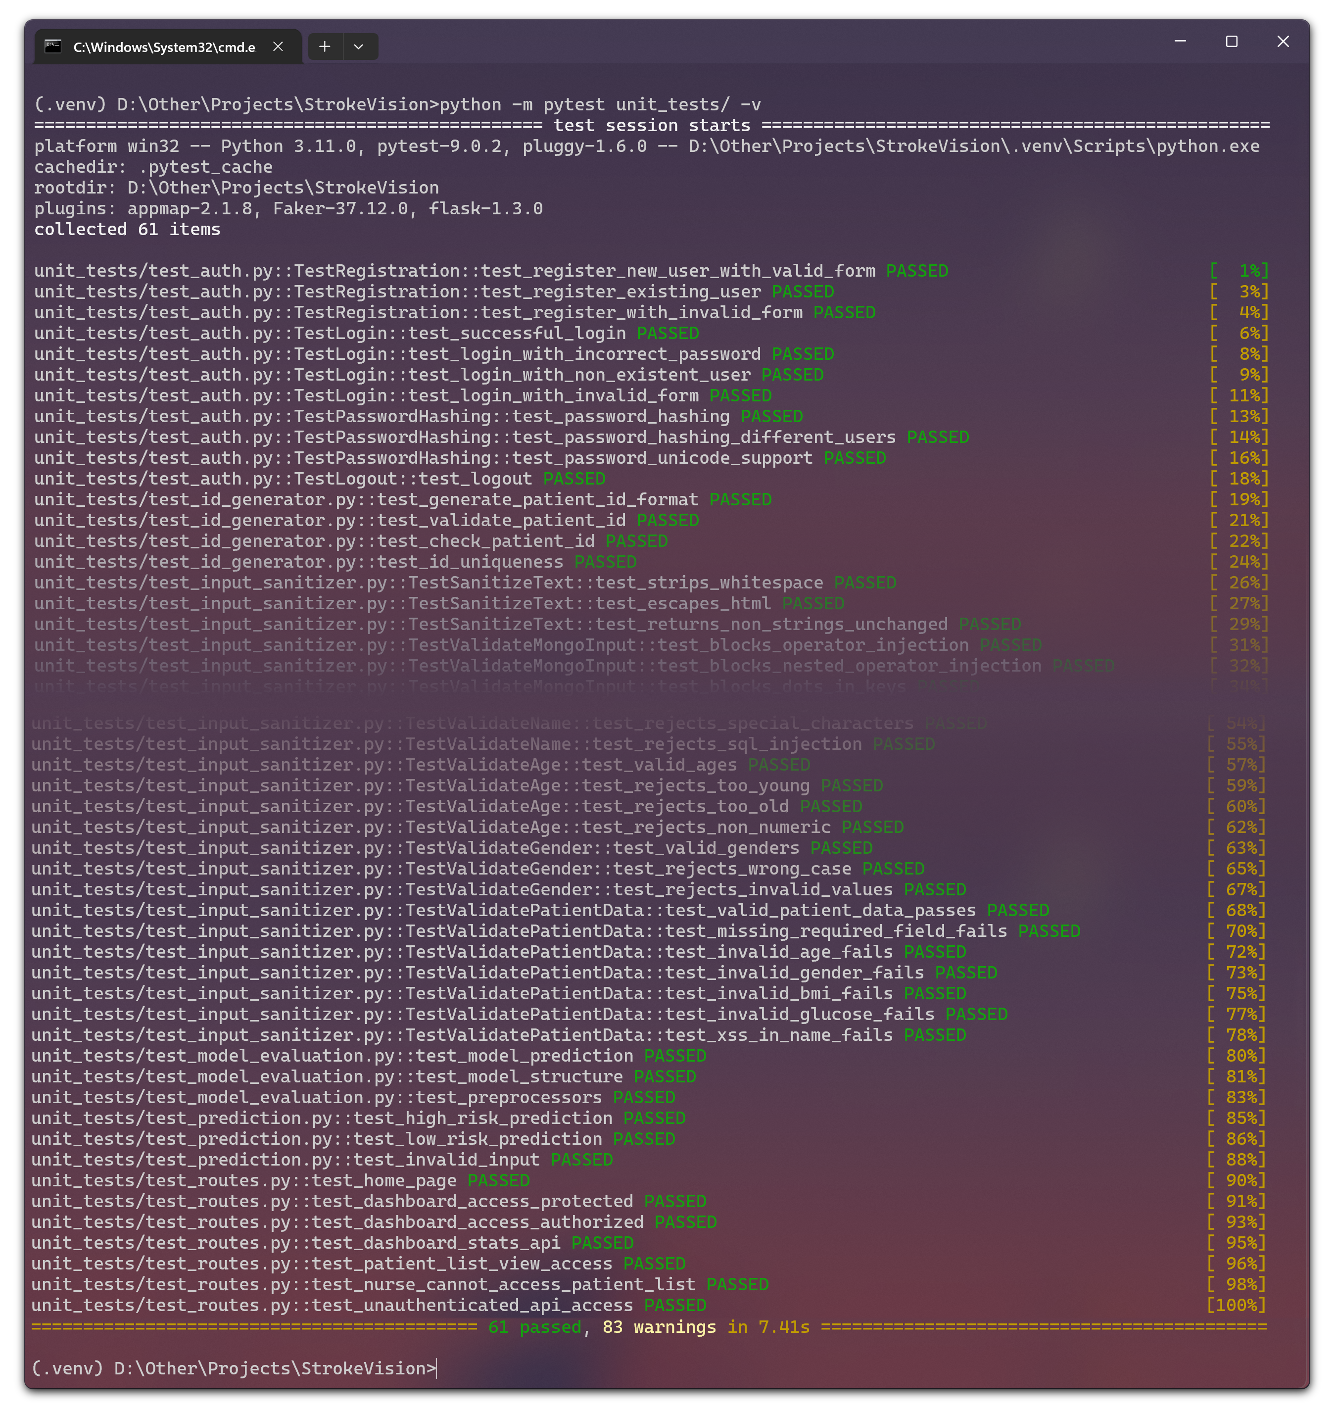
61 Unit Tests
Pytest

Slide 16
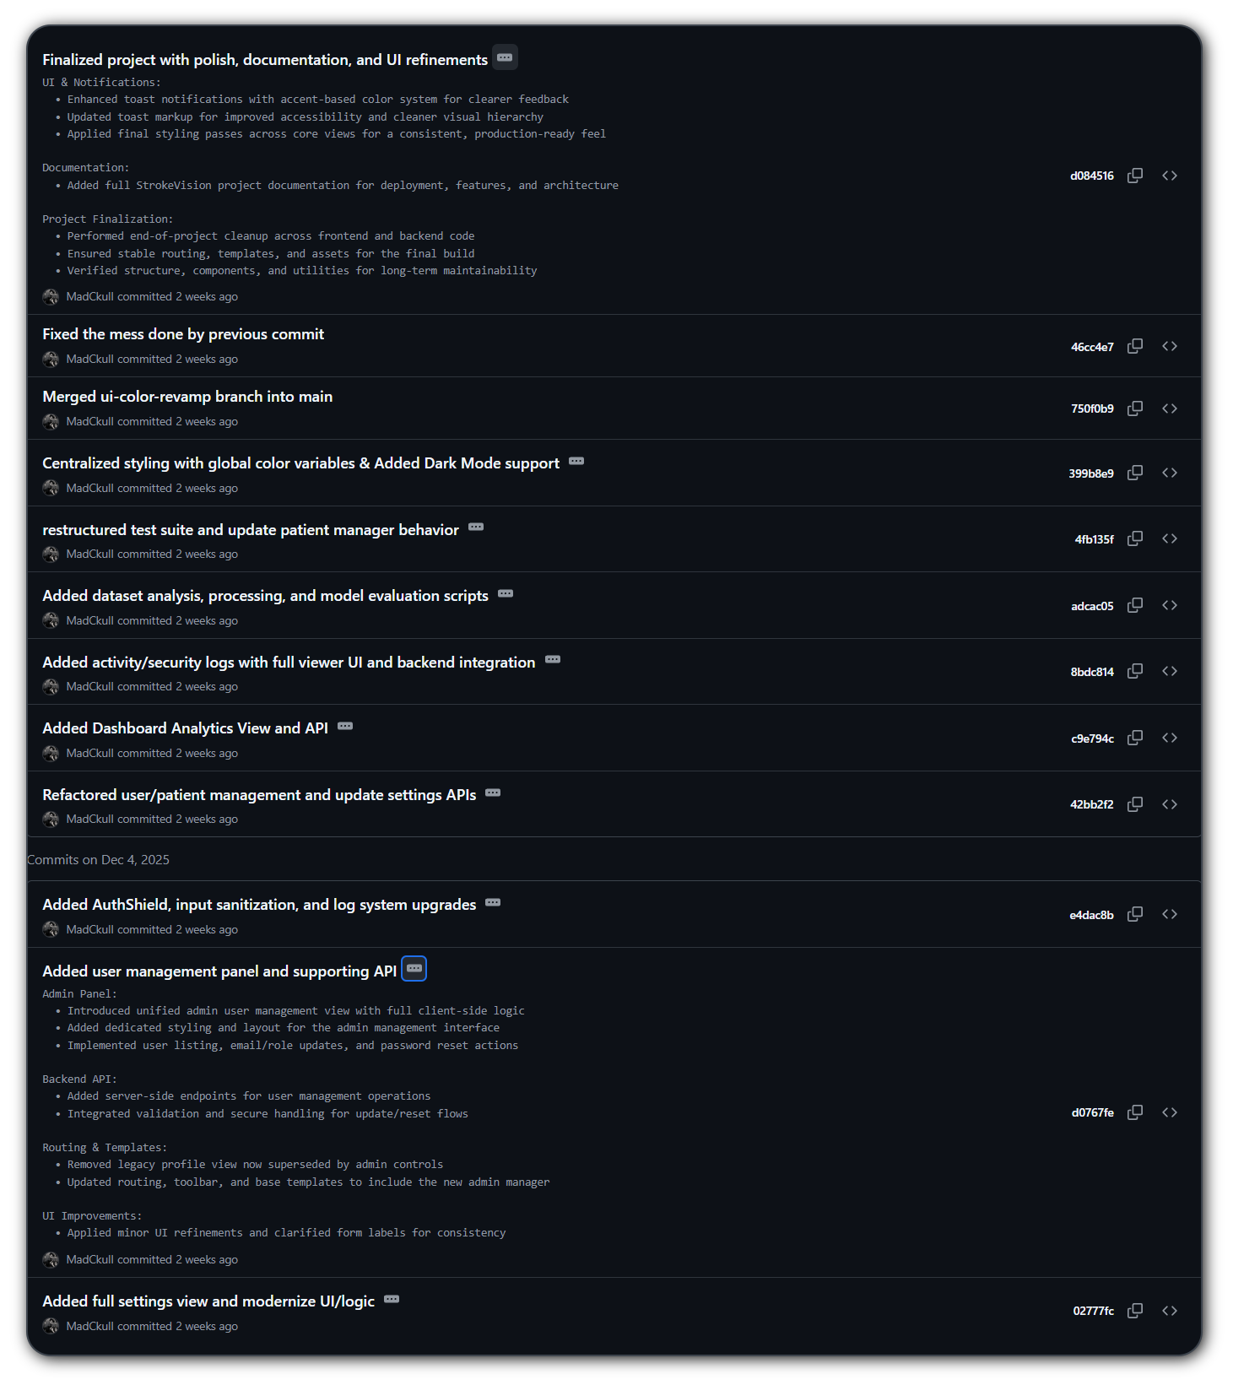

+31 Commits

Slide 17
Deployment Setup
Prerequisites
Future Roadmap
Python 3.11+ & pip
MongoDB instance
Configured .env file for secure keys.
Plan to containerize the entire application stack using Docker, ensuring reproducibility across different environments and simplifying production deployment.
One-Click Launch
Automated batch script handles venv creation, dependency installation, and server startup.
Just run StrokeVision.bat (On Windows)

Slide 18
OWASP Alignment
Access Control
Injection
Crypto Failures
A01: Mitigated via strict Role-Based Access Control (RBAC) and server-side route protection decorators. (Auth Shield)
A03: Prevented by using ORMs (SQLAlchemy, MongoEngine) and rigorous input validation via Flask-WTF & Input Sanitizer
A02: Addressed by enforcing Bcrypt hashing for all passwords and ensuring HTTPS readiness.
StrokeVision systematically addresses top security risks. By embedding security controls like ORMs and Bcrypt at the architectural level, I preemptively neutralize common threats like Injection and Cryptographic Failures.

Slide 19
Challenges & Lessons
DB Synchronization
Managing data consistency across two different database types (SQL vs NoSQL) was challenging but improved security posture.
Security vs Usability
Balancing strict input validation and CSRF protection while maintaining a seamless, error-free user experience.
Data Encryption vs Search Suggestions
Future: Encryption
A key limitation is lack of field-level encryption for patient names as Search suggestions wouldn’t work well with AES Encrypted data.

Slide 20
Student
Hassan Ali
Demonstration
Date
18-12-2025

